Slide 1
TESLA: STOCK PRICE PREDICTION
INFOSYS SPRINGBOARD INTERNSHIP FINAL EVALUATION

Slide 2
INTRODUCTION
The goal of this project is to predict whether Tesla's closing stock price will increase tomorrow compared to today. By utilizing machine learning techniques, we aim to develop models that can accurately classify future stock price movements. The challenge lies in predicting these movements using historical data and relevant market indicators.

Slide 3
ABOUT THE DATASET USED
With the Tesla stock price dataset containing features like high, low, open, close, and volume from 2010 to 2017, the task is to use these historical market indicators to predict if the stock price will increase the next day. This dataset provides valuable information about Tesla's price trends and trading volumes, which can be used to train machine learning models for classifying future price movements.

Slide 4
DATA LOADING AND CLEANING
No Missing Values
Every feature has complete data, ensuring a clean dataset for analysis.
Dataset Shape: (1692, 7)
There are 1692 rows (trading days) and 7 columns (features), indicating a decent amount of historical stock data.
Sufficient Data for Analysis
Since the dataset spans a significant period (likely around 6-7 years of trading days, assuming no weekends and holidays), it is useful for trend analysis and predictive modeling.

Slide 5
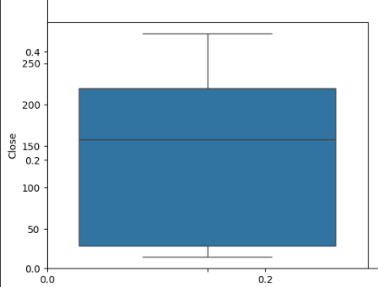
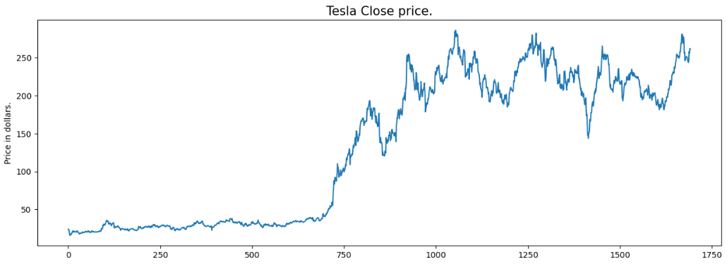
DATA VISUALIZATION (1/2)
1. Tesla Closing Price Trend
2. Stock Feature Distribution
3. Boxplot Analysis

Slide 6
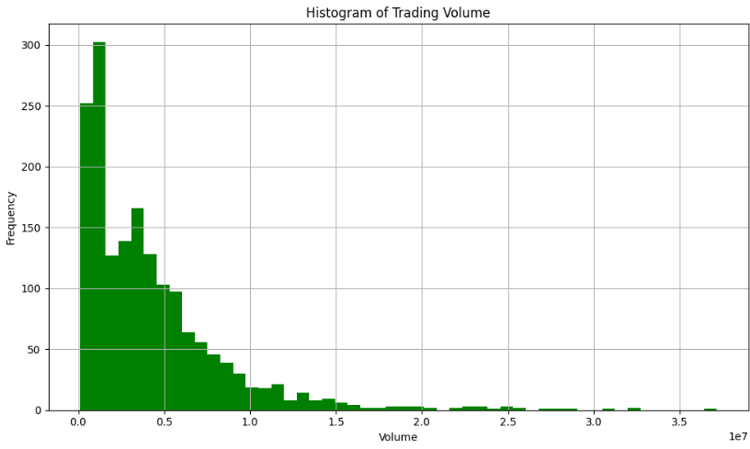
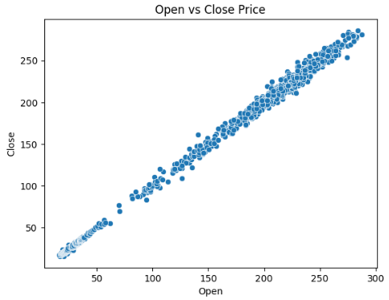
DATA VISUALIZATION (2/2)
4. Trading Volume Histogram
The histogram of the volume column shows how frequently different trading volume occur.
5. Open vs. Close Price Relationship
The scatter plot between Open and Close prices shows a positive correlation.

Slide 7
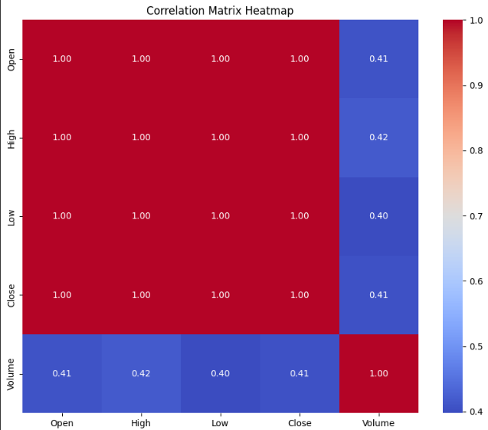
MULTIVARIATE ANALYSIS OF TESLA STOCK PRICES (1/3)
Correlation Matrix & Heatmap
Strong correlation among Open, High, Low, and Close prices (close to 1.00), meaning they move together.
Feature selection or dimensionality reduction may be useful for predictive modeling.
Trading Volume Distribution
Right-skewed distribution: Most trading days have low volume, but some experience extreme spikes.
High-volume trading days are rare but significant in influencing stock movement.

Slide 8
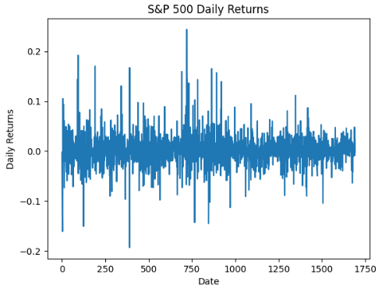
MULTIVARIATE ANALYSIS OF TESLA STOCK PRICES (2/3)
Candlestick Chart & High vs. Low Prices
Candlestick charts reveal daily price trends and bullish/bearish patterns.
High vs. Low Price Scatter Plot confirms strong correlation, reinforcing price movements.
Daily Returns Analysis
Volatility spikes due to market news, earnings, or economic events.
Above zero: Stock price increased compared to the previous day.
Below zero: Stock price decreased from the previous day.

Slide 9
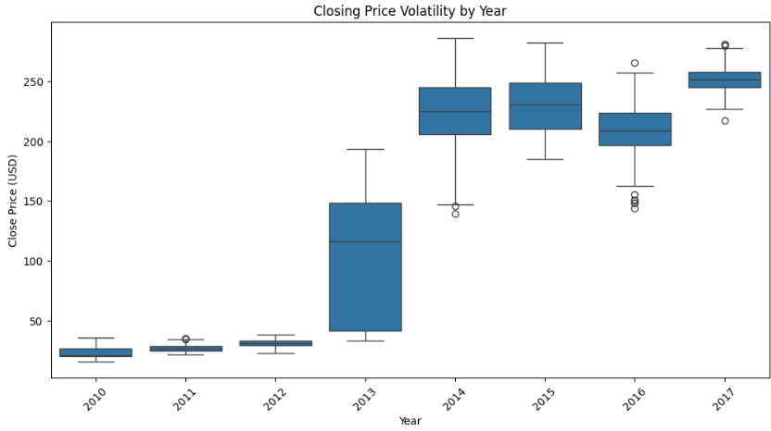
MULTIVARIATE ANALYSIS OF TESLA STOCK PRICES (3/3)
Closing Price Volatility (2010-2017)
2010-2012: Low & stable prices.
2013: Sharp price increase, rising volatility.
2014-2015: Peak volatility with wide price dispersion.
2016-2017: Stabilization at higher levels with reduced fluctuations.
Key Insights
Stock prices are highly correlated, making feature selection important.
Trading volume is right-skewed, with occasional high-volume days impacting stock trends.
Volatility peaked in 2014-2015 and later stabilized, indicating changing market dynamics.

Slide 10
BIVARIATE ANALYSIS
Scatter plots (Open vs. Close, Volume vs. Close) visualize relationships between variables, revealing trends or patterns.
The correlation matrix (heatmap) quantifies relationships among Open, High, Low, Close, and Volume. High values (close to 1 or -1) indicate strong correlations, while near-zero values suggest weak or no linear relationships.
The joint plot (Open vs. Close) combines scatter and distribution plots, with a regression line highlighting trend direction and correlation strength.

Slide 11
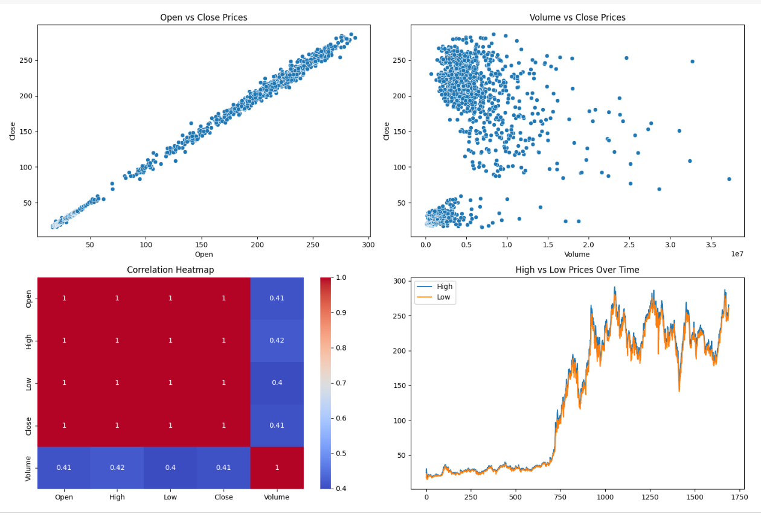
BIVARIATE ANALYSIS

Slide 12
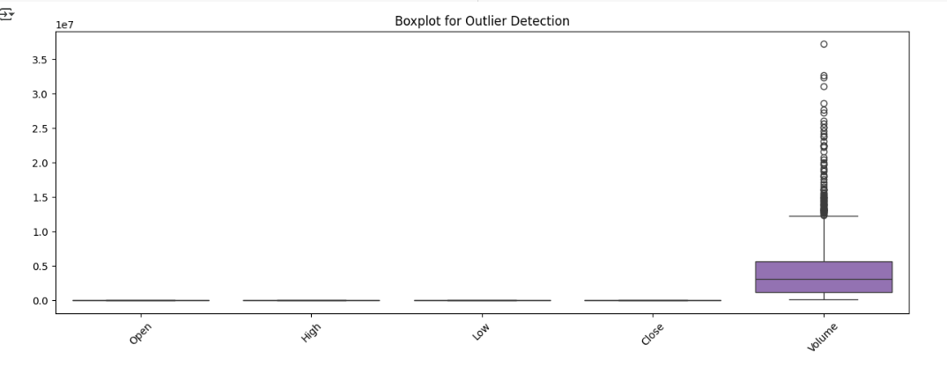
DETECTING OUTLIERS
Box Plot: Visualizes data distribution and highlights outliers beyond 1.5 times the IQR, aiding in anomaly detection.
Z-Score: Measures deviation from the mean; values beyond ±3 are outliers, useful for identifying extreme data points.
IQR Method: Identifies outliers outside the first and third quartile range, helping detect significant variations.

Slide 13
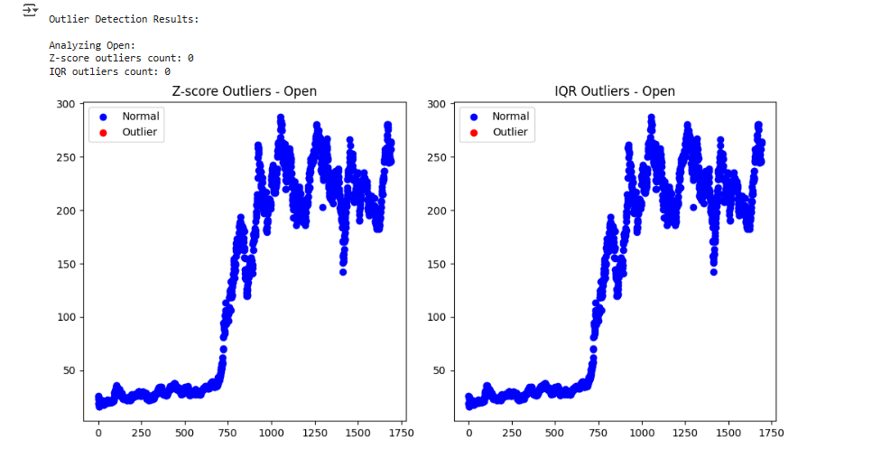
Z-SCORE AND IQR OUTLIERS

Slide 14
FEATURE ENGINEERING
Feature engineering is the process of selecting, modifying, or creating variables (features) from raw data to improve the performance of machine learning models. It plays a critical role in determining the effectiveness of the model, as well-crafted features can enhance model accuracy, while poorly designed ones can limit it.
Key Steps in Feature Engineering:
Understand the Data
Feature Selection
Feature Transformation
Feature Creation
Handling Outliers
Feature Encoding for Non-Numeric Data
Dimensionality Reduction

Slide 15
Tools for Feature Engineering:
Pandas: For data manipulation and preprocessing.
Scikit-learn: For scaling, encoding, and feature selection.
Visualization: Seaborn, Matplotlib, or Plotly to explore relationships.

Slide 16
Extracted Features & Outcomes:
Open_Close_Spread
High_Low_Spread
Quarter_End_Flag
Daily_Return
Selected Features (RFE): ['Open', 'High', 'Close']
Feature VIF
0 Open 3041.333729
1 High 5202.275625
2 Low 4198.414262
3 Close 3941.486016
4 Volume 2.171202

Slide 17
LABEL ENCODING
1. What is Label Encoding?
Label Encoding converts categorical values into numerical representations, making them machine-readable.
It is commonly used in feature engineering for stock market data preprocessing.
2. Data Sorting & Preparation
The dataset is sorted by date to ensure chronological order.
Label encoding is applied to numerical stock features to categorize price movements.
3. Binning Stock Prices into Categories
The stock prices (Open, High, Low, Close) are grouped into bins (e.g., Low, Medium, High).
This helps simplify patterns and detect market trends.

Slide 18
PCA(1/2)
1. What is PCA?
Principal Component Analysis (PCA) is a dimensionality reduction technique that transforms high-dimensional data into fewer uncorrelated components while preserving the most important information.
2. Applying PCA to Stock Data
Selected Features: High, Low, Open, Close (binned categories), and Volume.
Standardization: Features are scaled using StandardScaler to ensure equal weightage.
PCA Components: Reduced dimensions from 5 features to 2 principal components (PCA1 & PCA2) for visualization.

Slide 19
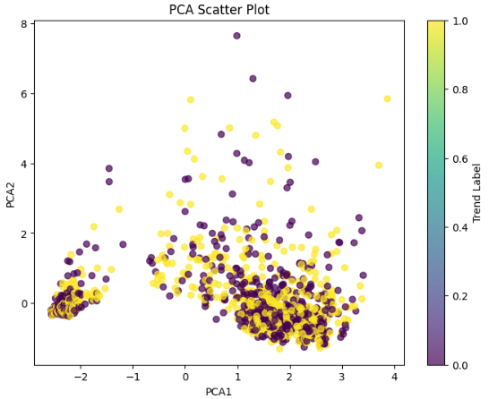
PCA(2/2)
3. Explained Variance & Insights
PCA1 explains 76.69% of the variance.
PCA2 explains 19.49% of the variance.
Cumulative Variance: 96.18% of data variation is retained in just two dimensions!

Slide 20
FEATURE SELECTION
Why?
Improves accuracy, reduces redundancy, prevents overfitting.
Key Features:
Stock Prices (Open, High, Low, Close) – Highly correlated.
Trading Volume – Weak correlation but affects volatility.
Technical Indicators – SMA, EMA, RSI, MACD.
Market Sentiment – News and social media trends.
Approach:
Correlation Analysis, Feature Importance, PCA.

Slide 21
CHI-SQUARE TEST & PERMUTATION IMPORTANCE FEATURE
Chi-Square Test
Purpose: Identifies relationships between categorical variables.
Application: Analyzes trading volume vs. price movement and market sentiment impact.
Key Insight: Low p-value (< 0.05) indicates significant influence on stock prices.
PIF
Purpose: Measures feature impact on model accuracy.
Application: Assessed stock prices, volume, indicators, and sentiment.
Key Insight: Higher importance scores highlight key drivers of predictions.

Slide 22
RFE & CORRELATION IN TESLA STOCK PREDICTION
RFE (Recursive Feature Elimination)
Purpose: Selects the most important features by removing the least impactful ones.
Application: Identified key predictors from stock prices, trading volume, and indicators.
Key Insight: Refines the model by retaining the most influential features.
Correlation
Purpose: Measures relationships between features and stock price.
Application: Analyzed correlations among stock prices, volume, and sentiment.
Key Insight: Strong correlations within price features; weak correlation between volume and price.

Slide 23
HYPERPARAMETER TUNING
Grid Search: Exhaustive search over a predefined set of parameters.
Hyperopt: Uses Bayesian optimization to find the best hyperparameters efficiently.
Optuna: Optimizes hyperparameters using a pruning strategy for faster convergence.
Bayesian Optimization: Models the objective function to choose the most promising parameters iteratively.
After tuning, the accuracy of Logistic Regression, SVC, and XGBoost improved significantly when trained with the best hyperparameters.

Slide 24
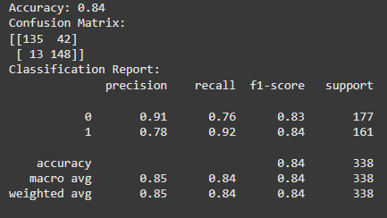

MODELS USED
Logistic Regression: Simple, interpretable, good for binary classification, but struggles with non-linear data.
SVC (Support Vector Classifier): Finds optimal decision boundary, handles complex patterns, but slow for large datasets.
XGBoost: Fast, accurate, handles missing values, but requires tuning

Slide 25
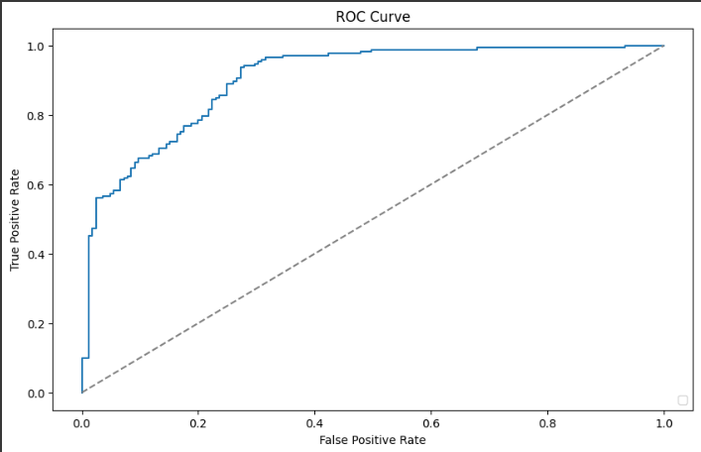
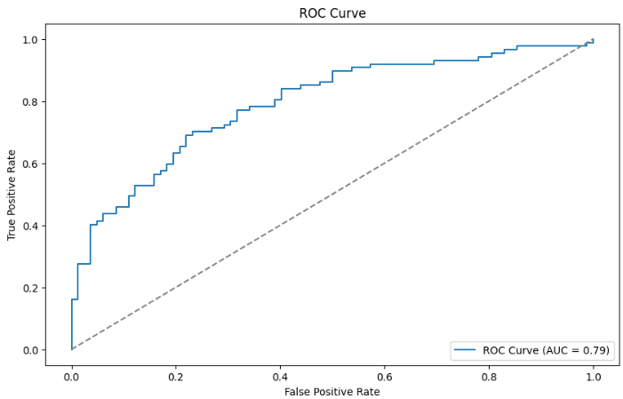

Slide 26
STREAMLIT DEPLOYMENT
Streamlit was used to deploy the app for an interactive user experience.
Why Streamlit?
Easy & Fast: Turns Python scripts into web apps quickly.
Interactive UI: Supports widgets for real-time updates.
Seamless Integration: Works well with ML models and visualizations.
Our models are now live, allowing real-time predictions.

Slide 27
KEY TAKEAWAYS
Dataset & EDA:
Data from 2010-2017 (1692 trading days, 7 features).
Exploratory analysis revealed strong correlations among price features, right-skewed trading volume, and evolving volatility trends.
Feature Engineering:
Created new features (e.g., Open_Close_Spread, Daily_Return, High_Low_Spread, Quater_End_Flag).
Applied label encoding, PCA (capturing 96% variance in 2 components), and RFE for key feature selection.
Modeling & Tuning:
Compared Logistic Regression, SVC, and XGBoost.
Hyperparameter tuning (Grid Search, Bayesian Optimization, etc.) significantly improved model accuracy.
Deployment: Interactive prediction app built with Streamlit for real-time user engagement.

Slide 28
THANK YOU

